Slide 1
NET. 012
C# Syntax
Class 2
Notes:
Title Slide

Slide 2
Agenda
Common Language Runtime
Variables
Initialization
Type Inference
Scope
Constants
Predefined Data Types
Casting
Parse and TryParse
Nullable Types
Notes:
Section Start Slide

Slide 3
Common Language Runtime (CLR)
The CLR manages your application
Memory management
Operating system and hardware independence
Language independence
Code that you develop with a language compiler that targets the runtime is called ‘managed code’

Slide 4
Class Library
A library of functions to build applications
The CL is a library of
Classes
Interfaces
Value and Reference types
It is the foundation on which .NET applications, components, and controls are built.

Slide 5
C#
One of the (several) languages of .NET
Allows you to create
Applications
Services
Reusable libraries
Syntax is similar to (but better than ☺ ) Java, C++, JavaScript

Slide 6
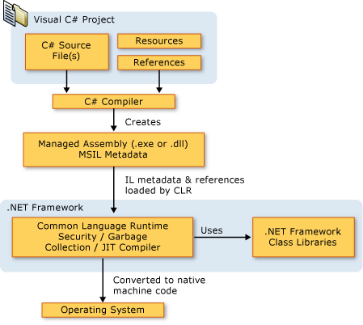
Putting it all together

Slide 7
Variables
You declare variables in C# using the following syntax:
datatype identifier;
E.g. int i;
This statement declares an int (type) named i (identifier)
The compiler won’t actually let you use a variable in an expression until you have initialized it with a value.

Slide 8
Initialization of Variables
The C# compiler requires that any variable be initialized with some starting value before you refer to that variable in an operation.
Two methods for ensuring that variables are initialized before use:
Variables that are fields in a class or struct are by default zeroed out when they are created
Variables that are local to a method must be explicitly initialized in your code prior to any statements in which their values are used.

Slide 9
Type Inference
Type inference makes use of the var keyword.
The compiler can infer what the type of the variable is by what the variable is initialized to.
int somevar = 0; becomes var somevar = 0;

Slide 10
Variable Scope
The scope of a variable is the region of code from which the variable can be accessed.
In general, the scope is determined by the following rules:
A field of a class is in scope for as long as its containing class is in scope.
A local variable is in scope until a closing brace indicates the end of the block statement.
A local variable that is declared in a for, while, or similar statement is in scope in the body of that loop.

Slide 11
Scope Clashes for Local Variables
It’s common in a large program to use the same variable name for different variables in different parts of the program.
Variables with the same name can’t be declared twice in the same scope.
https://dotnetfiddle.net/zce7hB

Slide 12
Constants
A constant is a variable whose value cannot be changed throughout its lifetime.
e.g.:
const int a = 100;
They must be initialized when they are declared.
The value of a constant must be computable at compile time.
Constants are always implicitly static.

Slide 13
Predefined Data Types
C# distinguishes between two categories of data type:
Value types
Reference types
The difference is that a value type stores its value directly, whereas a reference type stores a reference to the value.

Slide 14
Value and Reference Types
These types are stored in different places in memory:
Value types are stored in an area known as the stack
Reference types are stored in an area known as the managed heap.
Reference types are (usually) initialized with the ‘new’ keyword
https://dotnetfiddle.net/lDW0pf

Slide 15
Predefined Value Types
Integer Types (whole number)
sbyte, short, int, long …
Floating-Point Types (smaller floating-point values)
float, double
Decimal Type (higher-precision floating-point values)
decimal
Boolean Type (true / false)
bool
Character Type (single alphanumeric)
char

Slide 16
Predefined Reference Types
Object
object - The root type. All other types (including value types) are derived from object.
String
string - Unicode character string

Slide 17
Casting
The process of converting compatible types
Types of casts:
Implicit conversions
No special syntax is required because the conversion is type safe and no data will be lost. (smaller to larger)
Explicit conversions
Explicit conversions require a cast operator. Casting is required when information might be lost in the conversion, or when the conversion might not succeed for other reasons.
https://dotnetfiddle.net/pR0o6D

Slide 18
Parse and TryParse
The process of converting between different types.
Parsing is interpreting a value from a form with no intrinsic relationship
There is no *direct* relationship between a string and an int, but we can parse a string into an int.
https://dotnetfiddle.net/jasDDM

Slide 19
Nullable Types
A nullable type can represent the correct range of values for its underlying value type, plus an additional null value.
Nullable types are instances of the System.Nullable<T> struct.
The syntax T? is shorthand for Nullable<T>, where T is a value type. The two forms are interchangeable.

Slide 20
THANK YOU.
Notes:
Sign Off Slide

